Slide 1
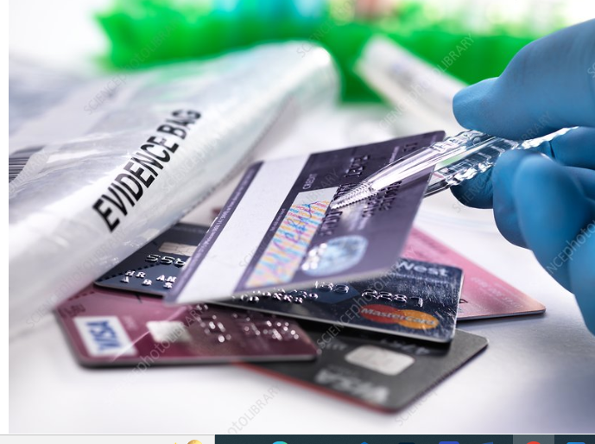
Project:Credit card fraud detection Phase-3
Team members
Chiristopher Jacob
Subash
Stabin
jayamurugan

Slide 2
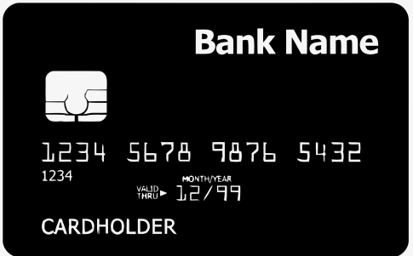
contents
Introduction
Problem definition
Proposed solution
Block diagram
Implementation
Innovation
code
Hardware and software requirements
Benefits
Result and conclusion

Slide 3
Introduction
Online shopping one of the fastest growing trend.
Mode of payments - credit card, debit card, net banking
Online payments does not require physical card
Major risk is credit/debit card details are not known to other

Slide 4
Problem definition
Anyone who know the details of card can make fraud transactions
Currently the card holder comes to know only after the fraud transaction is carried out
No mechanism to track the fraud transaction
Online payment does not require physical card

Slide 5
Types of fraud
Counterfeit credit cards.
Lost or stolen cards.
Card not present fraud.
phishing
Non receipt fraud
Identifying theft fraud

Slide 6
Proposed solution
A mechanism is developed to determine the money transaction is fraud or not
Hidden markov model to detect the fraud transaction
This model uses a works on the basis of spending habit of user

Slide 7
Three categories
Low
Medium
High

Slide 8
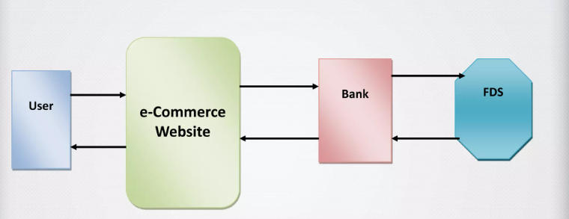
Block diagram

Slide 9
Determine techniques
Hidden markov model
It Is an automatic techniques.
It is a finite set of states
Decision trees
extracted from if then expressions
all the text have to succeed if each rule is to be generated
K-nearest neighbor algorithm
locate the nearest neighbors
easy detect the frauds
initially trained with card holder.
Separates the complex problem into many simple ones
resolves the sub problems through repeatedly using.
Logistic regression
important techniques is data mining which is together called logistic regression

Slide 10
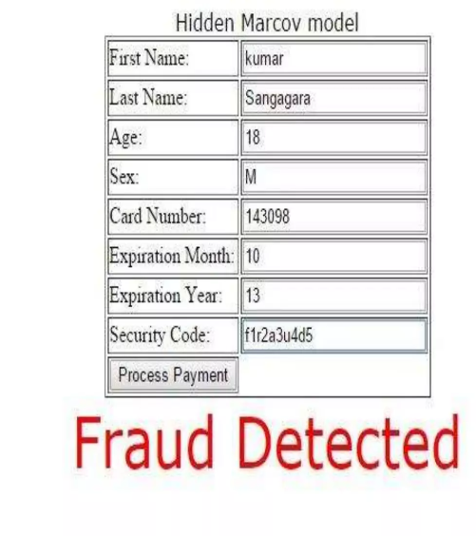
Example of hidden markov model

Slide 11
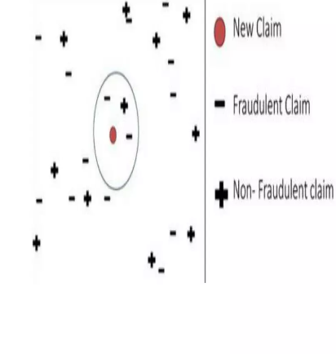
Example of k-nearest neighbor algorithm

Slide 12
Implementation of credit card fraud detection
HTML
it is used for interface designing
CSS
it is used for interface designing
javascript
it is used for client side validation
PHP
it is used for server side scripting
MYSQL
it is used for database.

Slide 13
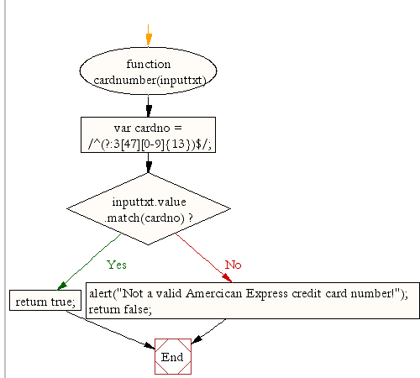
Flow chart

Slide 14
Innovation
Biometric credit cards avoid the fraudulent transaction with lost and stolen
Credit cards and banks Will test a biometric card in various markets
It launches 2021 and enjoy its ease of use

Slide 15
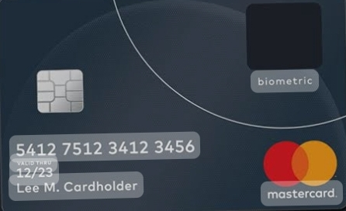
Biometric credit card
It is identify the authentication finger print in card holder
Already have a finger print as built-in
Pin entry or signature at the point-of-sale
Impossible to fraudulently authorized payment

Slide 16

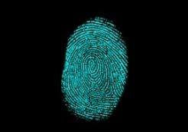
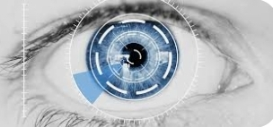
Methods
Finger print recognition:
Identify individual fingerprints
facial recognition :
Compare two sets of Facial images and confirm identity
Iris recognition :
Individual based on the unique patterns in their Iris.

Slide 17
Components of payment
Below we will uncover all the key components behind biometric payment technology:
Hardware:
POS terminal or biometric scanner, fingerprint scanner Iris scanner
Face recognition camera capture a users biometric data
2.Algorithm :
Sophisticated algorithm to process data and confirm the identity of users.

Slide 18
Working
Identity authentication :
This typically involves scanning their fingerprint, face, or iris to confirm their identity.
Processing :
This process involves verifying the user's payment credentials and authenticating the transaction with the relevant payment processor.
Authorization :
The payment is then authorized by the payment processor and the transaction is completed.

Slide 19
Working
Confirmation:
Finally, users will receive a notification to confirm that the transaction has been successful.

Slide 20
Benefits
Improved users experience
Enhanced data security
Reduced payment fraud
Greater convenience
Increased user privacy
Faster checkout times
Reduced administrative overhead

Slide 21
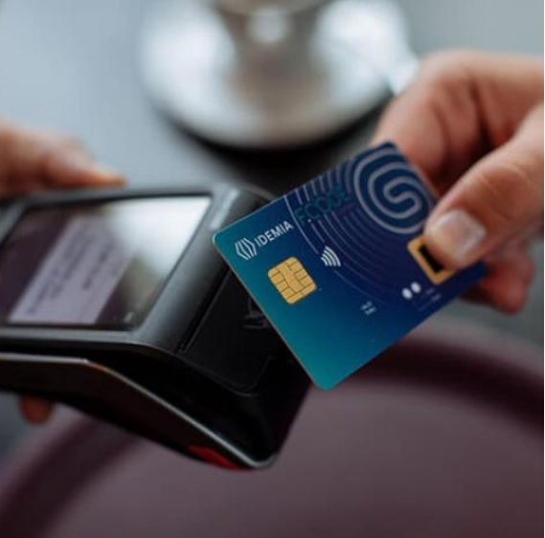
Benefits
8. Improve customer service
9. Reduced transaction costs
10. More accessible

Slide 22
Drawbacks of biometric credit cards
There are some potential drawbacks that users should be aware of before using them.
Initial cost:
Bio metric authentication can be expensive.
Privacy concerns:
information trends to be stored centrally and can quicked be share
Possible limitation in accuracy and performance:
Potentially leading to inaccurate readings and declined payment application.

Slide 23
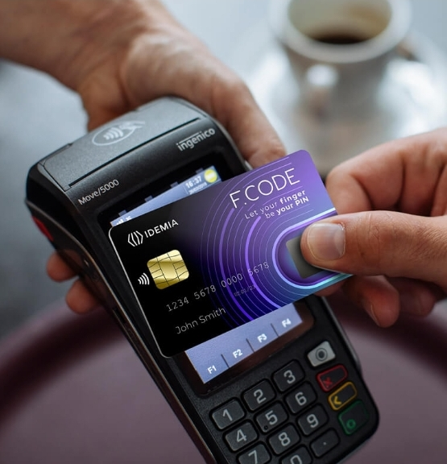
Cases
Online shopping
Banking
Retail stores

Slide 24
Code
import numpy as np
import pandas as pd
import sklearn
import scipy
import matplotlib.pyplot as plt
import seaborn as sns
from sklearn.metrics import classification_report,accuracy_score
from sklearn.ensemble import IsolationForest

Slide 25
from sklearn.neighbors import LocalOutlierFactor
from sklearn.svm import OneClassSVM
from pylab import rcParams
rcParams['figure.figsize'] = 14, 8
RANDOM_SEED = 42
LABELS = ["Normal", "Fraud"]

Slide 26
#import plotly.plotly as py
import plotly.graph_objs as go
import plotly
import plotly.figure_factory as ff
from plotly.offline import init_notebook_mode, iplot
linkcode
data =pd.read_csv ('/kaggle/input/creditcardfraud/creditcard.csv')
data.head()
data1= data.sample(frac = 0.1,random_state=1)data1.shapedata.isnull().sum()

Slide 27
data.describe()count_classes = pd.value_counts(data['Class'], sort = True)count_classes.plot(kind = 'bar', rot=0)plt.title("Transaction Class Distribution")plt.xticks(range(2), LABELS)plt.xlabel("Class")plt.ylabel("Frequency");
Normal = data[data['Class']==0]Fraud = data[data['Class']==1]Normal.shapeFraud.shapeNormal.Amount.describe()Fraud.Amount.describe()f, (ax1, ax2) = plt.subplots(2, 1, sharex=True)
f.suptitle('Amount per transaction by class')bins = 50ax1.hist(Fraud.Amount, bins = bins)ax1.set_title('Fraud')ax2.hist(Normal.Amount, bins = bins)ax2.set_title('Normal')plt.xlabel('Amount ($)')plt.ylabel('Number of Transactions')plt.xlim((0, 20000))

Slide 28
plt.yscale('log')plt.show();f, (ax1, ax2) = plt.subplots(2, 1, sharex=True)f.suptitle('Time of transaction vs Amount by class')ax1.scatter(Fraud.Time, Fraud.Amount)ax1.set_title('Fraud')ax2.scatter(Normal.Time, Normal.Amount)ax2.set_title('Normal')plt.xlabel('Time (in Seconds)')plt.ylabel('Amount')plt.show();init_notebook_mode(connected=True)plotly.offline.init_notebook_mode(connected=True) trace = go.Scatter(
x = Fraud.Time,
y = Fraud.Amount,
mode = 'markers'
)

Slide 29
data = [trace]
plotly.offline.iplot({
"data": data
})
Fraud = data1[data1['Class']==1]
Valid = data1[data1['Class']==0]
outlier_fraction = len(Fraud)/float(len(Valid))
print(outlier_fraction)
print("Fraud Cases : {}".format(len(Fraud)))
print("Valid Cases : {}".format(len(Valid)))

Slide 30
linkcode
correlation_matrix = data1.corr()
fig = plt.figure(figsize=(12,9))
sns.heatmap(correlation_matrix,vmax=0.8,square = True)
plt.show()

Slide 31
Hardware requirements
Pentium core2 duo processor
1 GB RAM
20GB HDD
router

Slide 32
Software requirement
Windows 7
wamp
macromedia

Slide 33
Benefits
The system stores previous transaction patterns for each user.
Based upon previous data of that user the system recognizes unusual patterns in the payment procedure.
The System will block the user for more than 3 invalid attempts.

Slide 34
Result and conclusion
Fraud detection is based on hidden markov model which is learning algorithm hence not 100% correct
The mechanism requires at least 10 transaction to determine accurately the transaction as fraud or not.

Slide 35
Thank you

